Slide 1

Creative Commons
& “Interface Design for Legal Systems”
New and Emerging Legal Infrastructures Conference (NELIC)
Mike Linksvayer
2011-04-15 / Berkeley

Slide 2
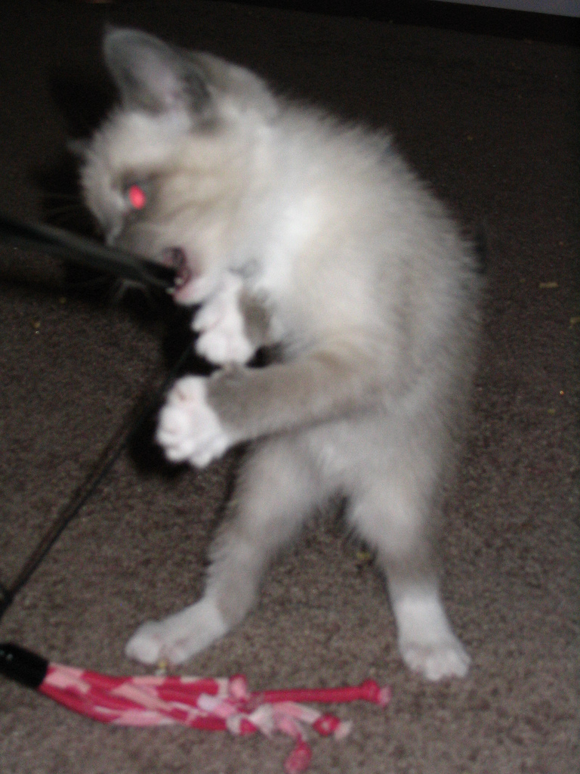
Really
Obscure
Fun
Licenses
flickr.com/photos/dcoetzee/3566415826/ · CC0

Slide 3
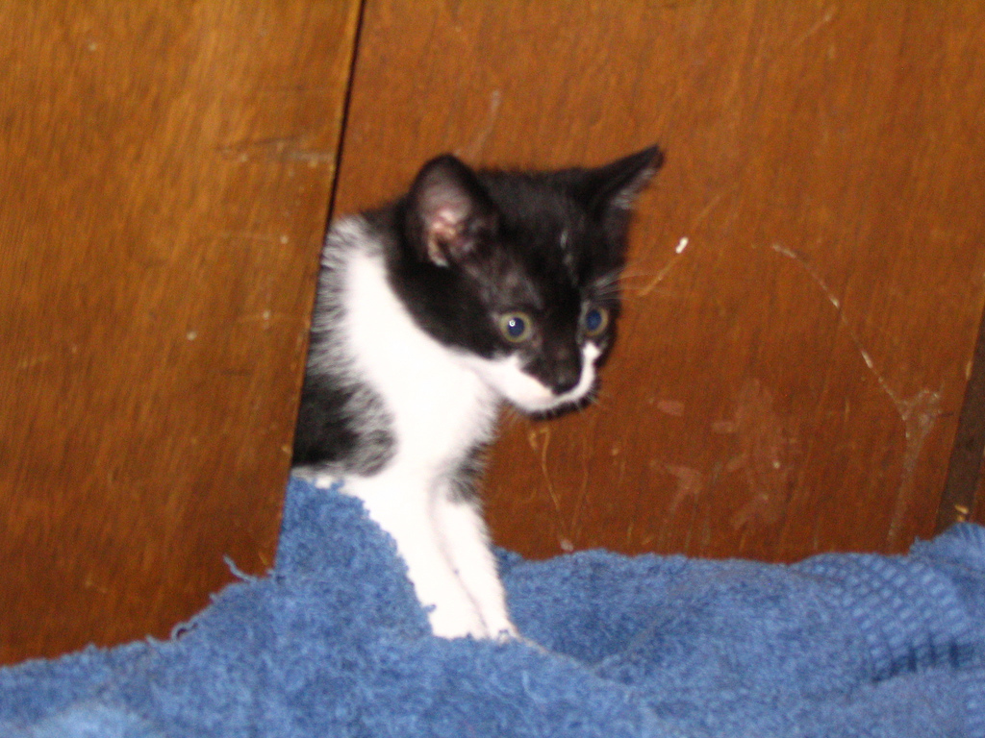
Really
Obvious
Fun
Licenses
flickr.com/photos/dcoetzee/3566410256/ · CC0

Slide 4
creative commons . org
non-profit organization
foundation, corporate, individual supporters
100+ global affiliate institutions

Slide 5
sharing infrastructure
respect the law, build a sustainable and scalable society
legal and technical tools enabling effective “some rights reserved” and “no rights reserved”
culture, education, public sector, science…

Slide 6
known for tools with ‘3 forms’
licenses, “legalcode”, “lawyer-readable”
“human-readable” “deeds”, buttons
“machine-readable” metadata

Slide 7
known for tools with ‘3 forms’
licenses, “legalcode”, “lawyer-readable”
“human-readable” “deeds”, buttons
“machine-readable” metadata

Slide 8
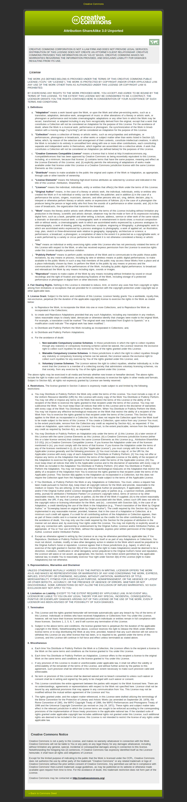

Slide 9
known for tools with ‘3 forms’
licenses, “legalcode”, “lawyer-readable”
“human-readable” “deeds”, buttons
“machine-readable” metadata

Slide 10







wikipedia

Slide 11
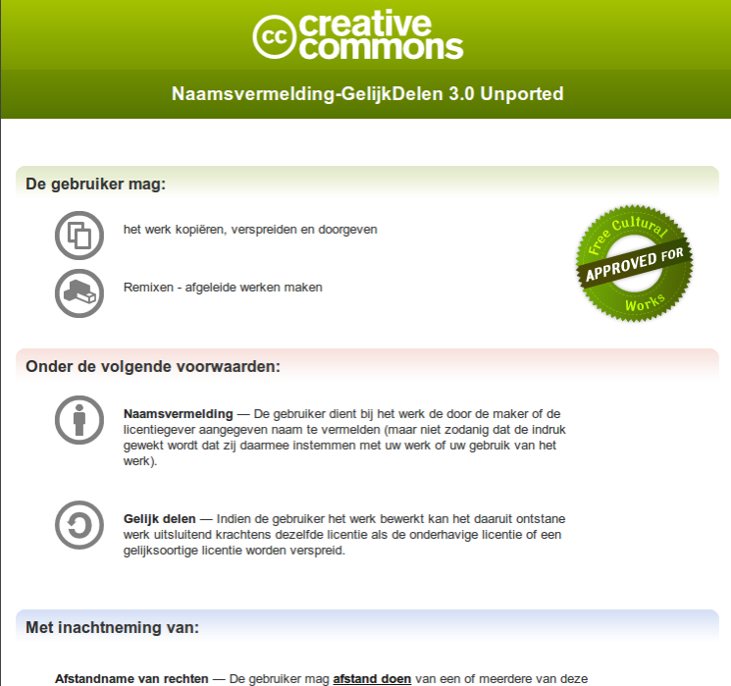

Slide 12
known for tools with ‘3 forms’
licenses, “legalcode”, “lawyer-readable”
“human-readable” “deeds”, buttons
“machine-readable” metadata

Slide 13
<rdf:RDF xmlns="http://creativecommons.org/ns#"
xmlns:rdf="http://www.w3.org/1999/02/22-rdf-syntax-ns#">
<License
rdf:about="http://creativecommons.org/licenses/by-nc-sa/3.0/">
<permits
rdf:resource="http://creativecommons.org/ns#Reproduction"/>
<permits
rdf:resource="http://creativecommons.org/ns#Distribution"/>
<requires
rdf:resource="http://creativecommons.org/ns#Notice"/>
<requires
rdf:resource="http://creativecommons.org/ns#Attribution"/>
<prohibits
rdf:resource="http://creativecommons.org/ns#CommericialUse"/>
<permits
rdf:resource="http://creativecommons.org/ns#DerivativeWorks"/>
<requires
rdf:resource="http://creativecommons.org/ns#ShareAlike"/>
</License>
</rdf:RDF>

Slide 14
<span xmlns:cc="http://creativecommons.org/ns#" xmlns:dc="http://purl.org/dc/elements/1.1/">
<span rel="dc:type" href="http://purl.org/dc/dcmitype/Text" property="dc:title">My Book</span> by
<a rel="cc:attributionURL" property="cc:attributionName" href="http://example.org/me">My Name</a>
is licensed under a
<a rel="license" href="http://creativecommons.org/licenses/by/3.0/">Creative Commons Attribution 3.0 License</a>.
<span rel="dc:source" href="http://example.net/her_book"/>
Permissions beyond the scope of this license may be available at <a rel="cc:morePermissions" href="http://example.com/revenue_sharing_agreement">example.com</a>.
</span>

Slide 15
all 3 are user interfaces for humans, and enable more such user interfaces:
lawyers, informed non-lawyers, policy
general public, general zeitgeist
software developers, cc-aware applications

Slide 16
legal user interfaces Я hard

Slide 17
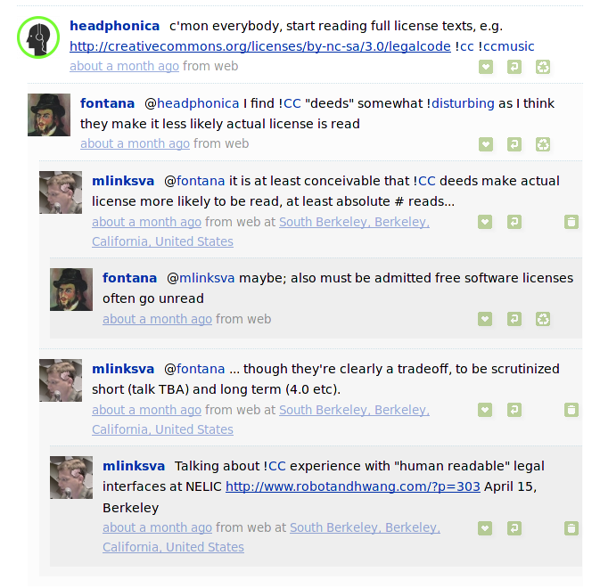

Slide 18
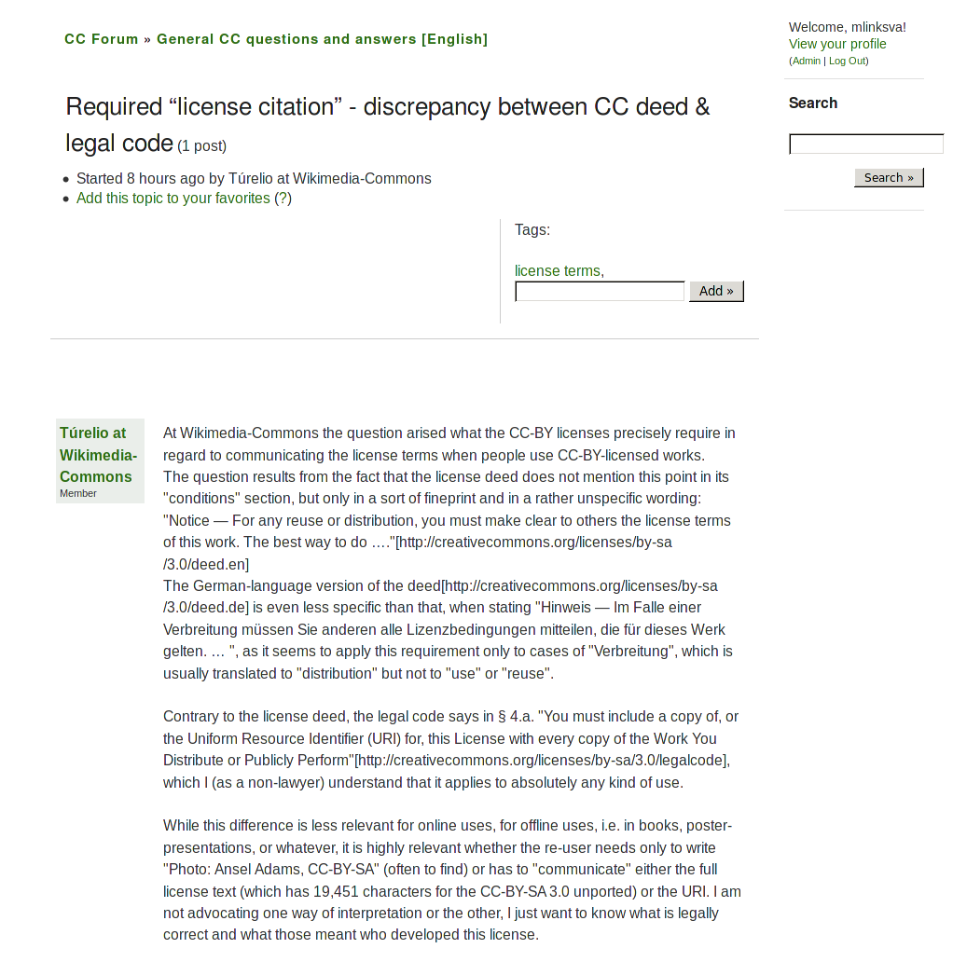

Slide 19
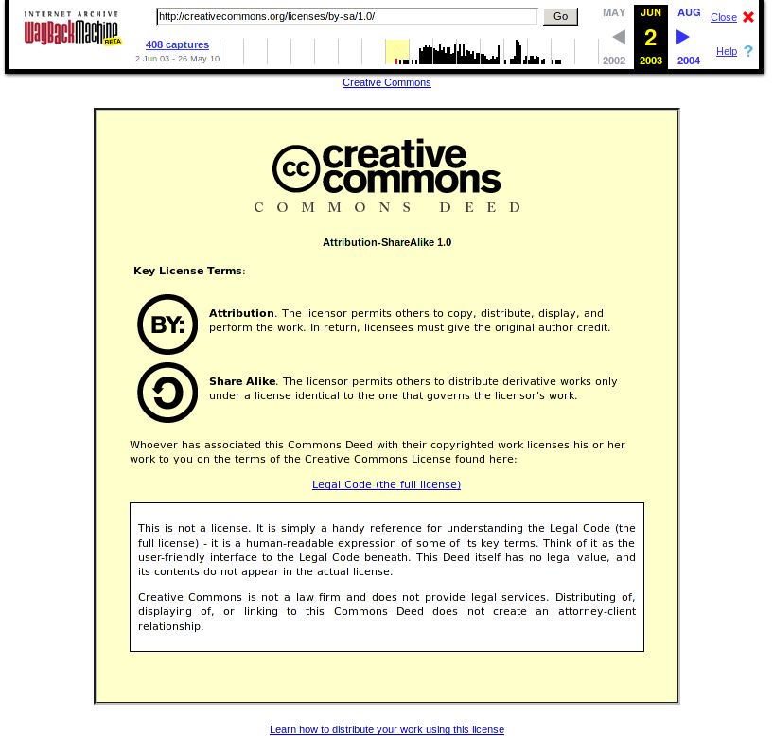

Slide 20
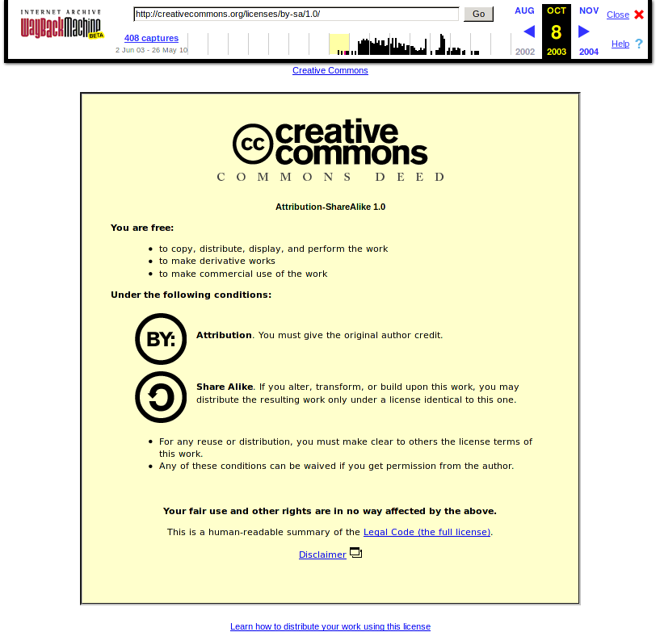

Slide 21
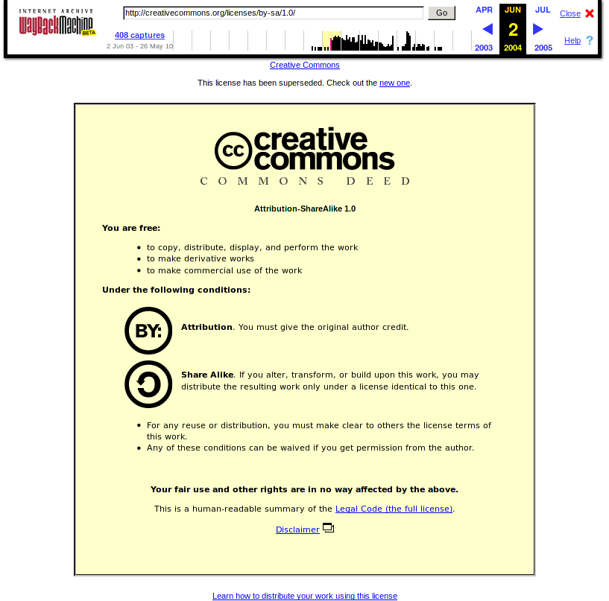

Slide 22
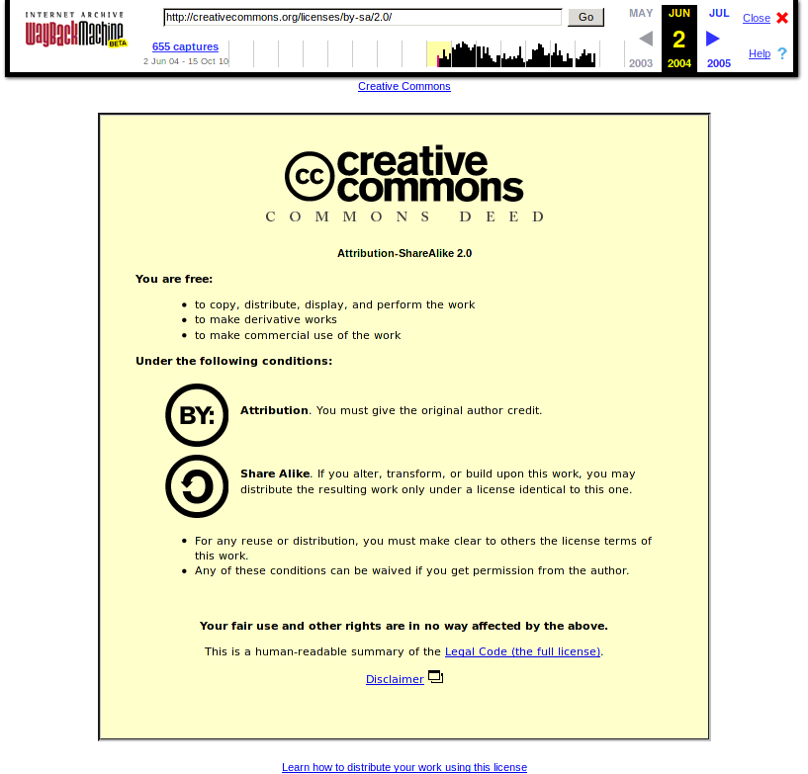

Slide 23
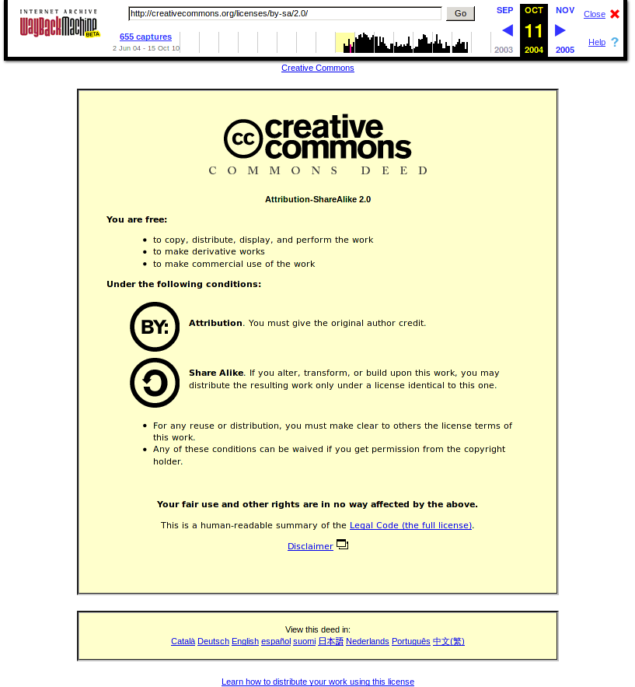

Slide 24
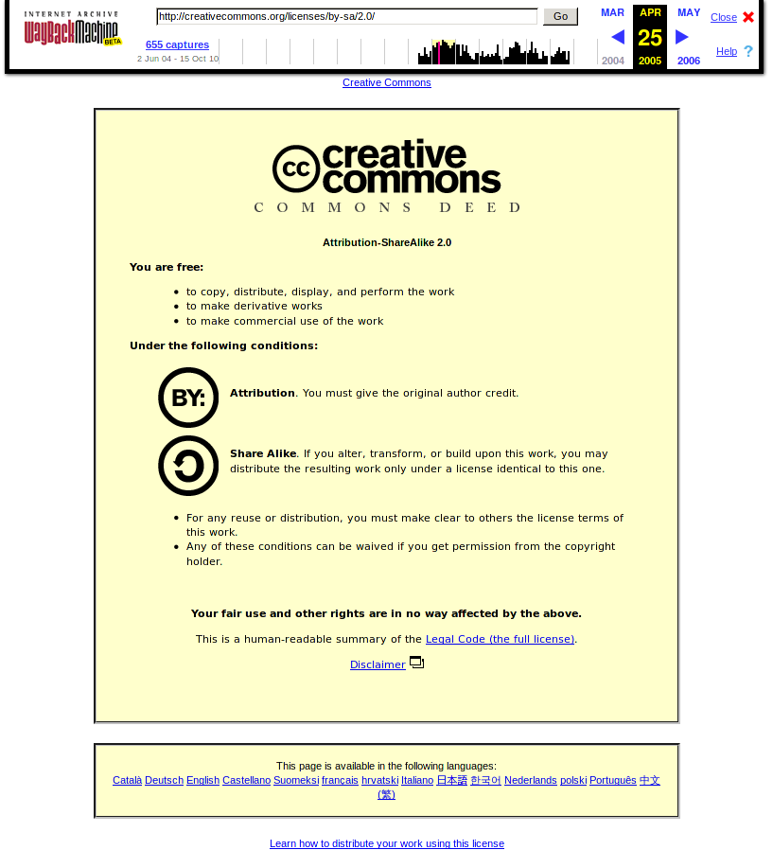

Slide 25
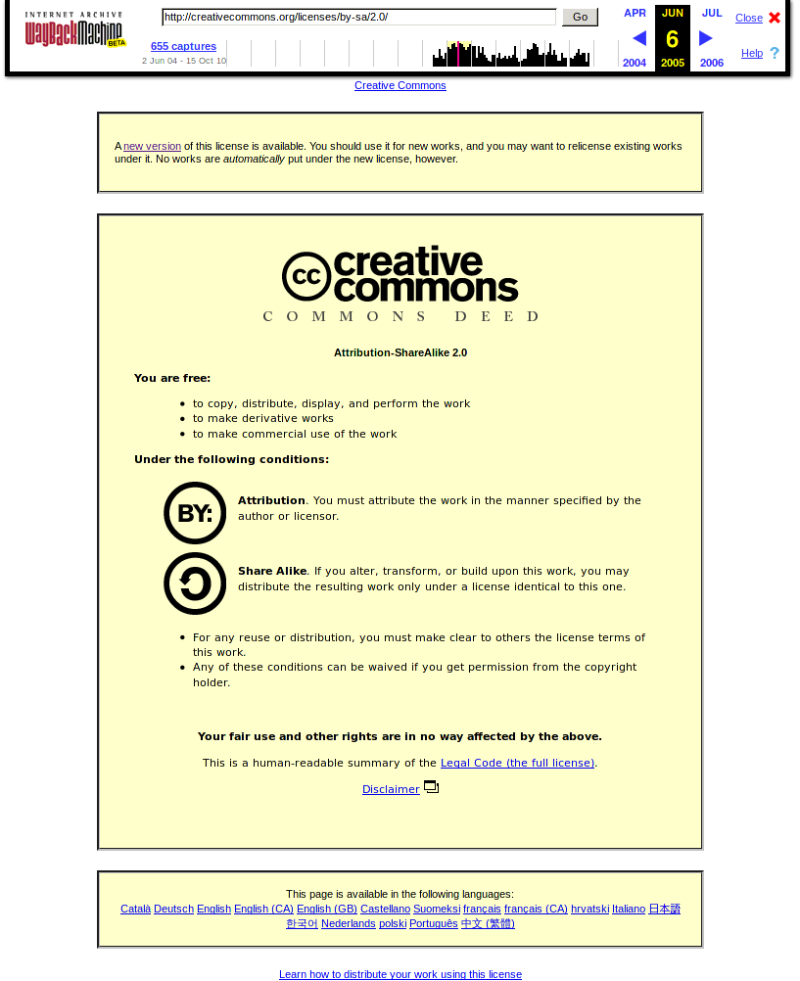

Slide 26
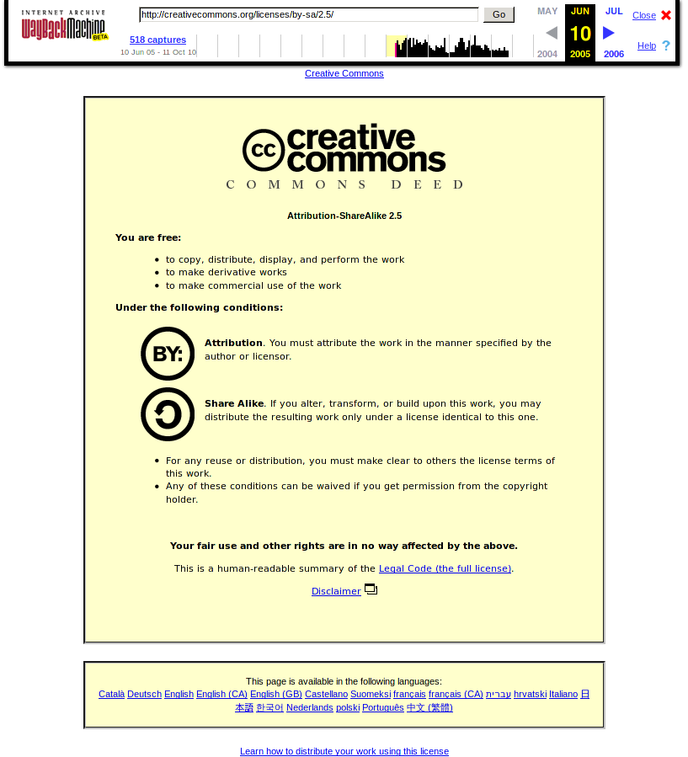

Slide 27
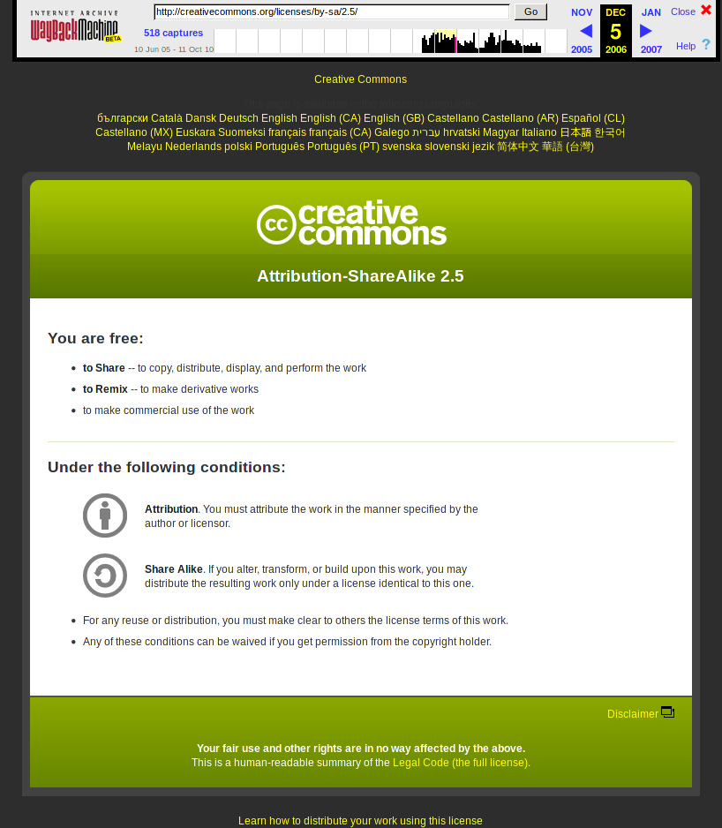

Slide 28
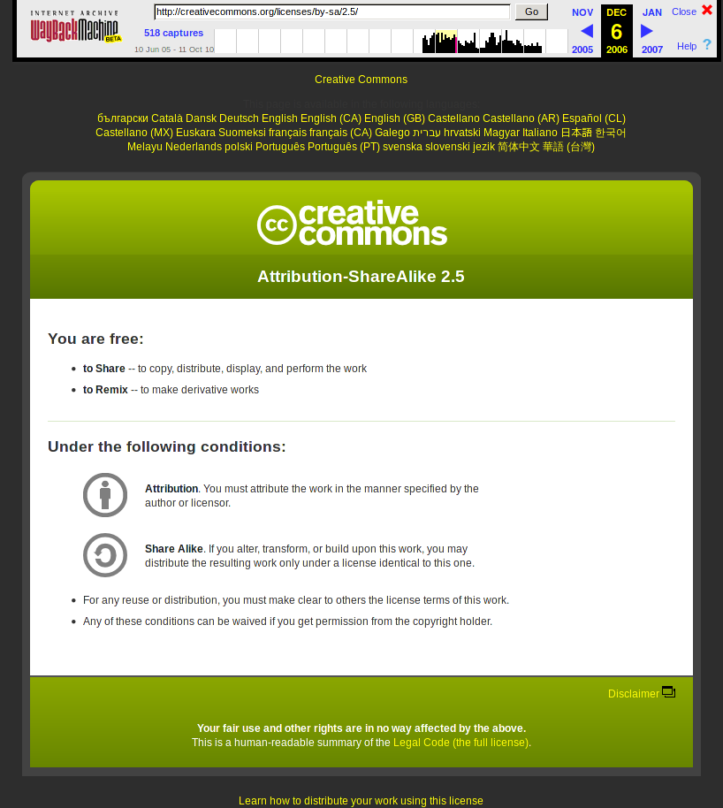

Slide 29
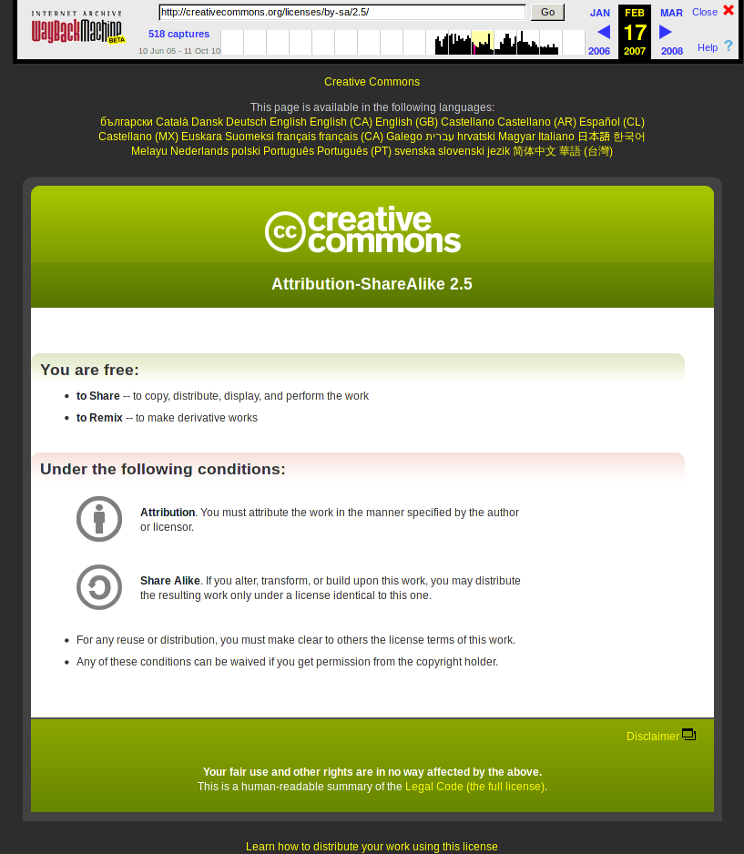

Slide 30
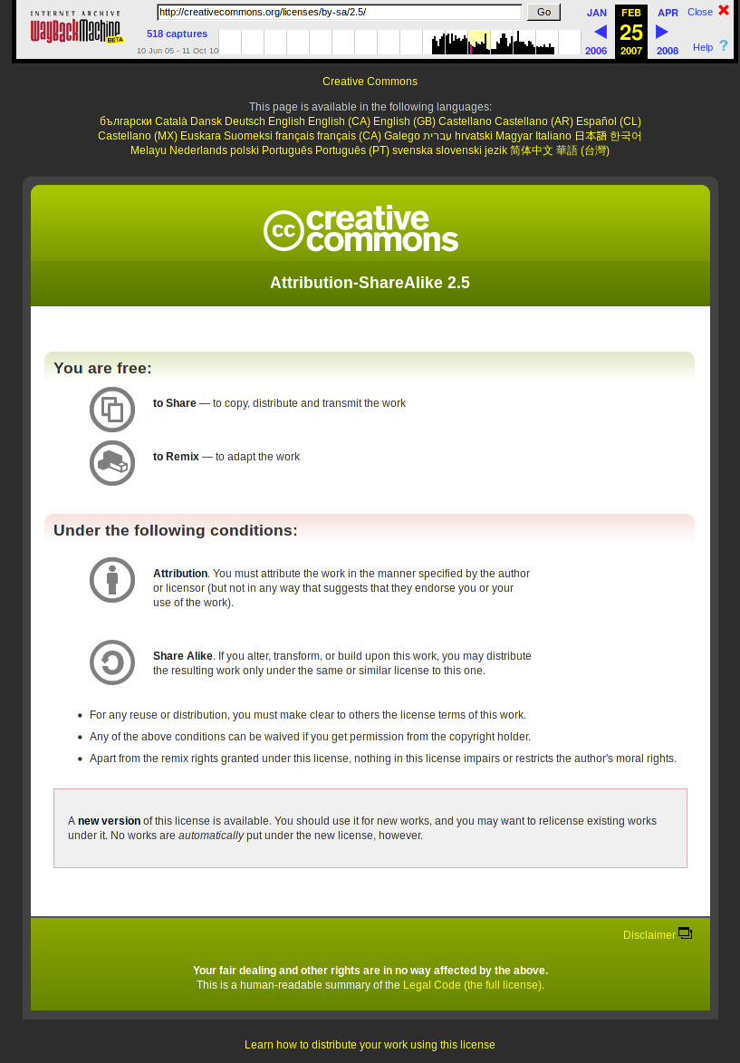

Slide 31
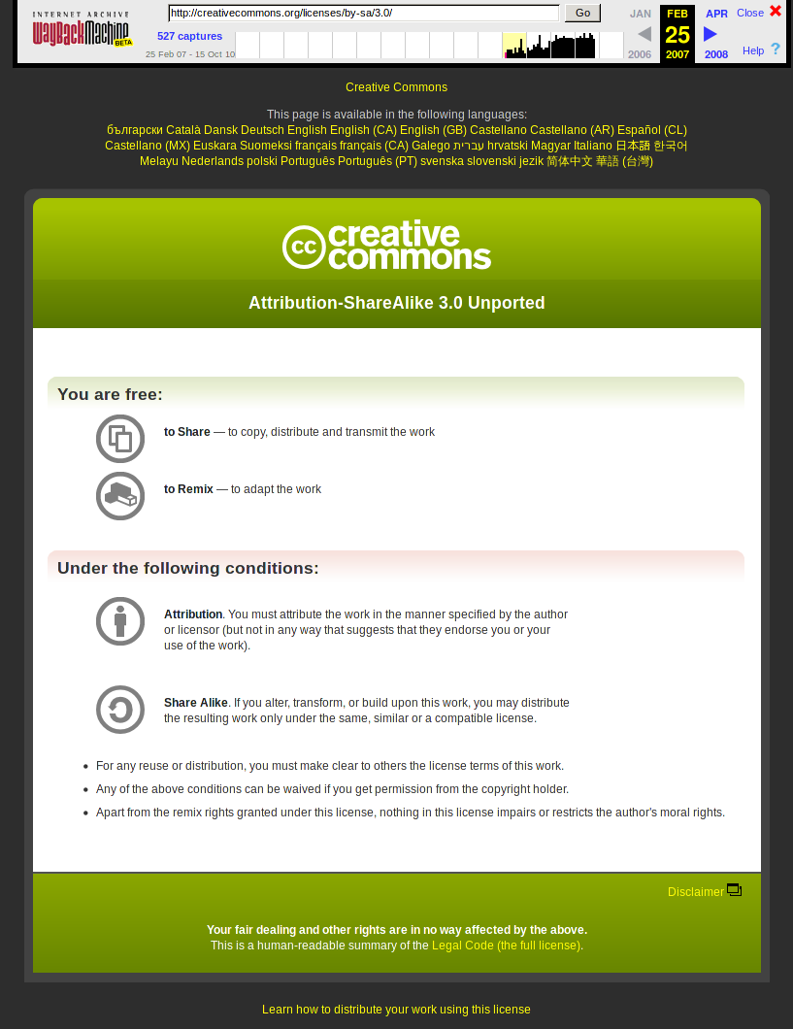

Slide 32
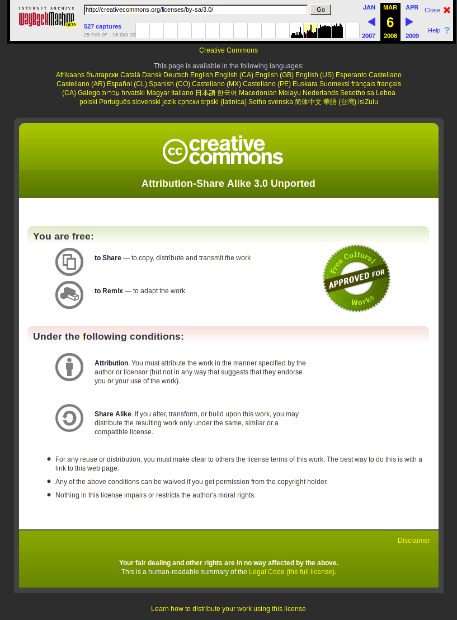

Slide 33
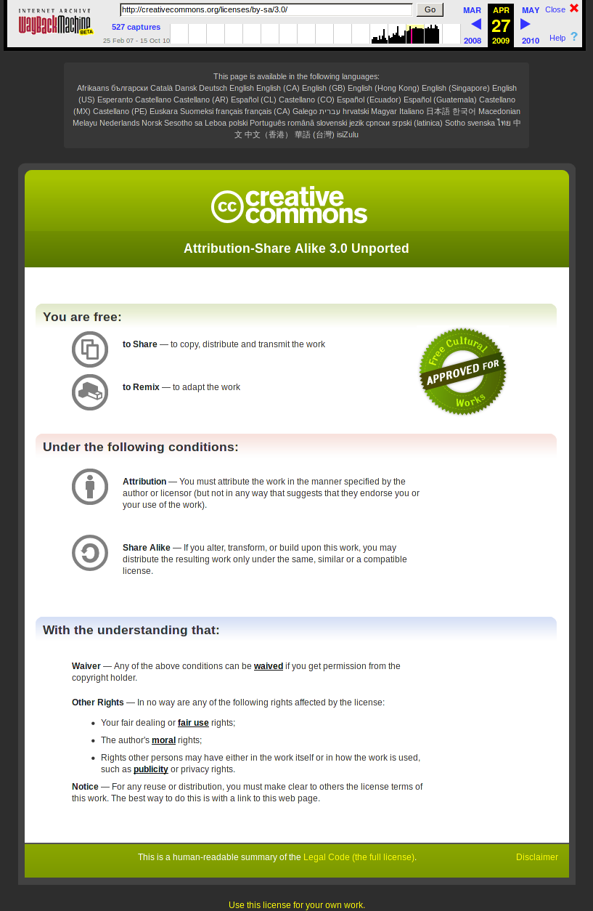

Slide 34
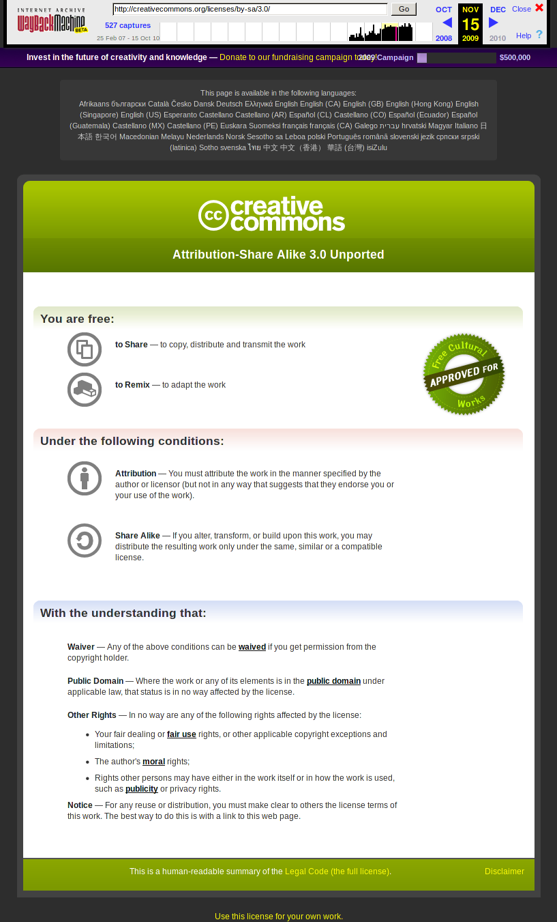

Slide 35
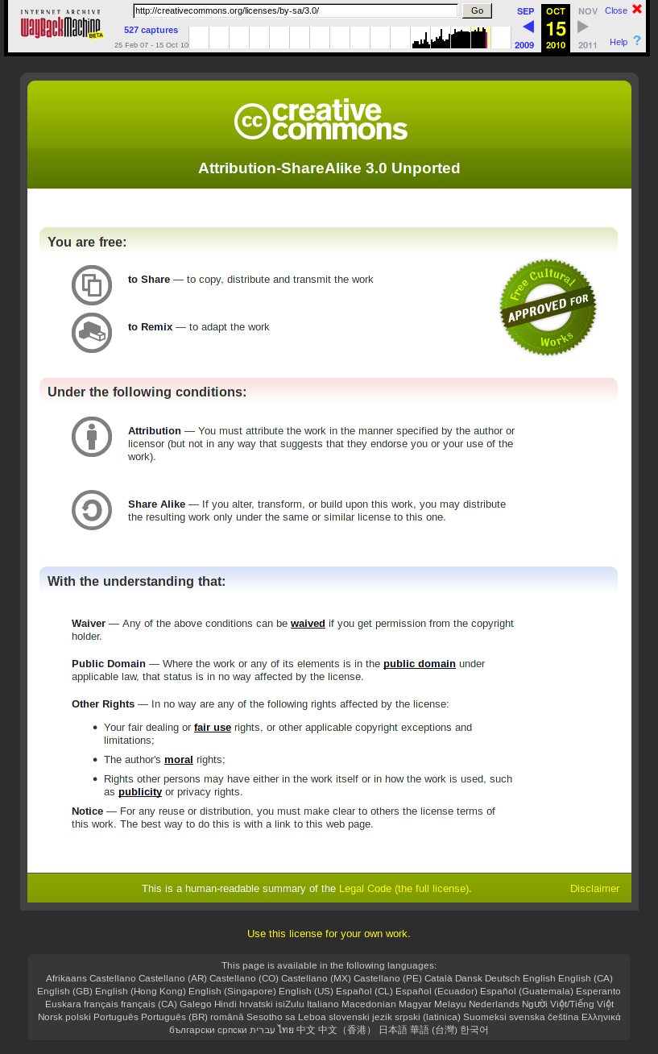

Slide 36
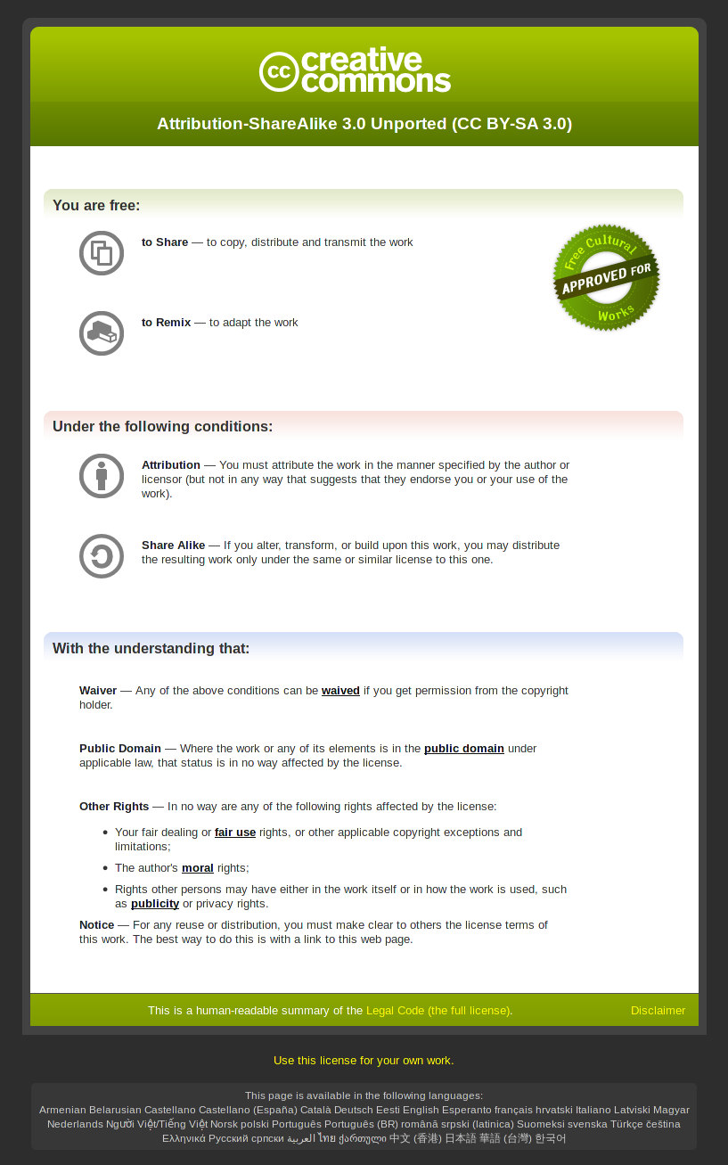

Slide 38
endless opportunities for legal user interface design

Slide 39
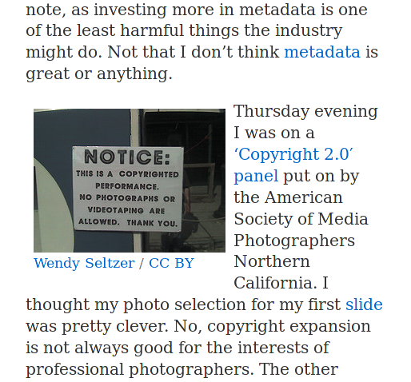

Slide 40
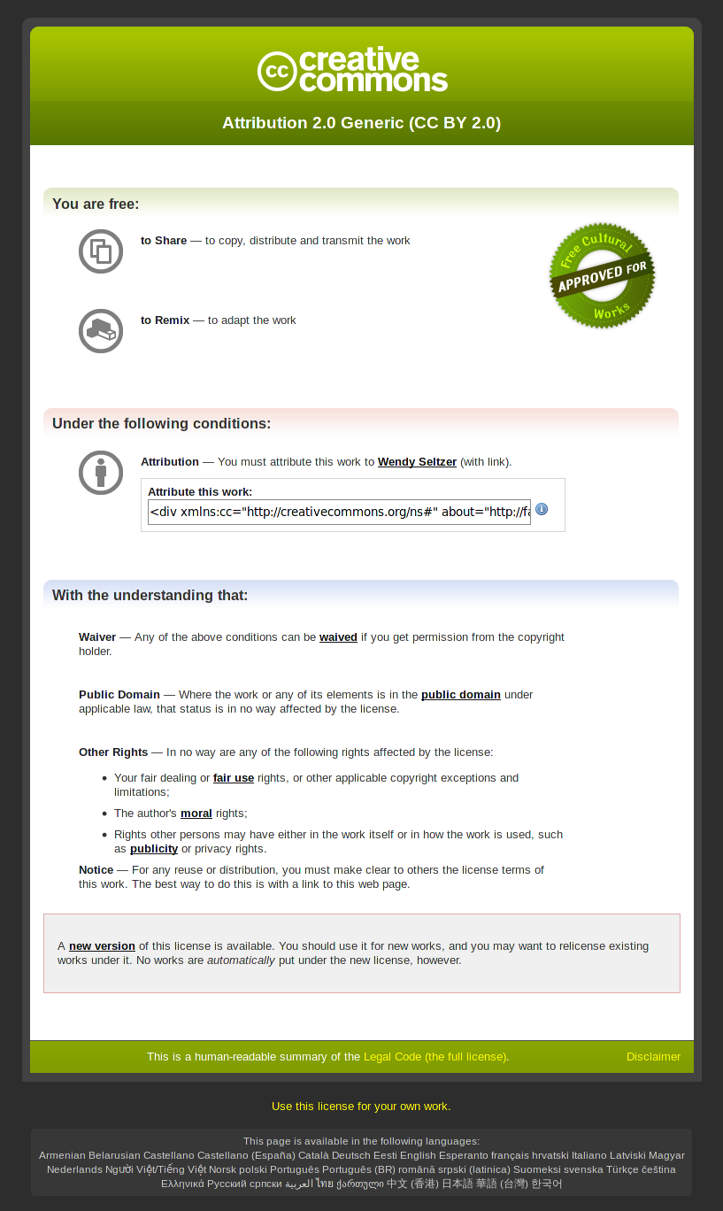

Slide 41
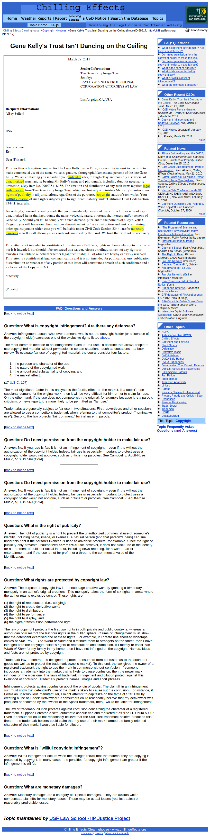

Slide 42
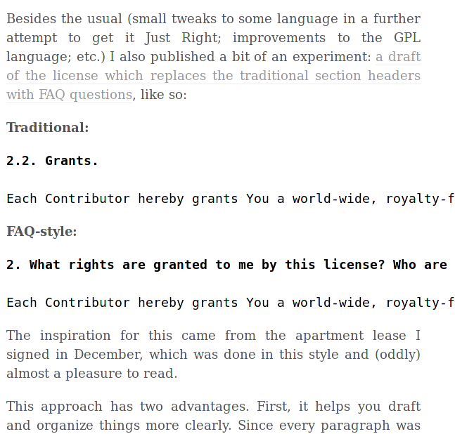
tieguy.org/blog/2011/03/31/mpl-beta-2-as-faq/

Slide 43
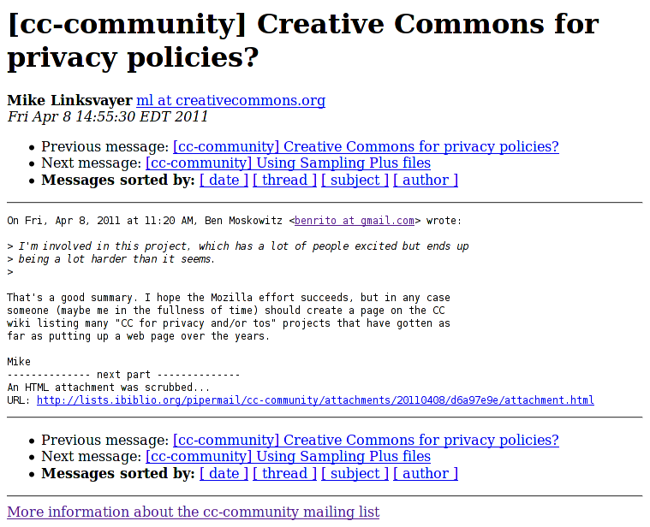

Slide 44
“cc for x” often sounds good, but not feasible for many values of x
public copyright licenses a naturally fairly constrained space
we work to keep space much more constrained than natural: “license proliferation” = broken commons, network effects left on table

Slide 45
consider, for all LUIs (assuming access, democratization as goals)
make the underlying legal arrangement conceptually simple and user-friendly (for several meanings of user-friendly!)
attempt simple and short legal documents
provide readily-accessible explanations, eg contextual FAQs

Slide 46
LUIcons (2)
can very small number of important legal concepts be distilled? maybe “cc like” icons will help, but don’t get stuck here
encourage an informed cadre to read and understand the “legalcode”

Slide 47
LUIcons (3)
non-English interfaces
modeling key legal concepts (e.g., with RDF) can force good thinking on all of above, or be a rathole!
what additional user interafaces might be enabled by a “machine-readable” interface?

Slide 48
LUIcons (4)
all of the democratic issues around standards, e.g.
free documentation
royalty-free patent permission
free/open source implementation
open-by-rule governance

Slide 49
links: convey yourself to
http://creativecommons.org
(Creative Commons NGO)
http://wiki.creativecommons.org/NELIC_LUI
(these slides)

